Slide 1
Biological Science Genetics
Year 10 Science

Slide 2
In this Daily Review
Prior to this part of the Masterclass Series, you have looked at the reteach, retrieve and apply instructional sequence and created one instructional sequence for one piece of content. Please fill in the table below for the content contained in the following Daily Review. You can use the slides in the rest of this PowerPoint to further denote what part of this sequence each slide refers to.
 | Concept (Facts, Ideas, Declarative Knowledge) |  | Skill
Content | Reteach | Retrieve | Apply (I Do) | Apply (We Do) | Apply (You Do)
describe the reasons for classification and how we use it every day
describe the role of classification keys and use dichotomous keys to identify unknown objects
describe the features of living things
recall that all living things are classified using the same hierarchical system (kingdom, phylum class order, family, genus, species) and that specific conventions apply for writing the name of a species.
describe the features of each of the five kingdoms of living things
describe the features of each of the 9 main phyla of the animal kingdom
describe the features of the main classes of chordates
How to shade table cells
Step 1: Click in the cell or highlight multiple cells
Step 2: In the top ribbon, click ‘Table Design’
Step 3: Click ‘Shading’
Step 4: Select the colour you wish to apply

Slide 3
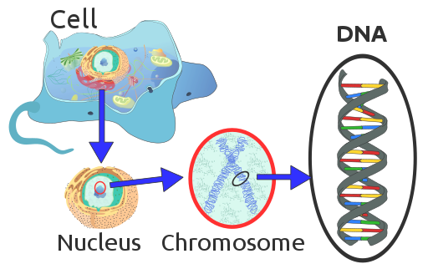
Introduction to DNA
In nearly all living things, the genetic information is contained in a complex molecule called DNA.
DNA stands for deoxyribonucleic acid.
The information determines what organs and parts should develop, the order in which these parts should be assembled and how they should work together.
DNA is found in the nucleus of a cell.
Teacher Cue
Active tracking, choral reading

Slide 4
Introduction to DNA
In nearly all living things, the genetic information is contained in a complex molecule called DNA.
DNA stands for deoxyribonucleic acid.
The information determines what organs and parts should develop, the order in which these parts should be assembled and how they should work together.
DNA is found in the nucleus of a cell.
Teacher Cue
Active tracking, choral reading

Slide 5
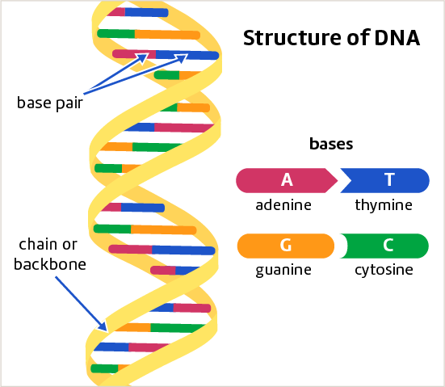
Structure of DNA
Teacher Cue
Active tracking, choral reading
DNA consists of two chains or “backbones” that twist around each other. This structure is known as a double helix.
Each step on the ladder is made up of two smaller molecules, known as bases.
The four bases are:
1. Adenine (A)
2. Thymine (T)
3. Guanine (G)
4. Cytosine (C)
Adenine (A) joins with Thymine (T) A-T
Guanine (G) joins with Cytosine (C) C-G
These pairings are called base pairs

Slide 6
Structure of DNA
Teacher Cue
Active tracking, choral reading
DNA consists of two chains or “backbones” that twist around each other. This structure is known as a double helix.
Each step on the ladder is made up of two smaller molecules, known as bases.
The four bases are:
1. Adenine (A)
2. Thymine (T)
3. Guanine (G)
4. Cytosine (C)
Adenine (A) joins with Thymine (T) A-T
Guanine (G) joins with Cytosine (C) C-G
These pairings are called base pairs

Slide 7
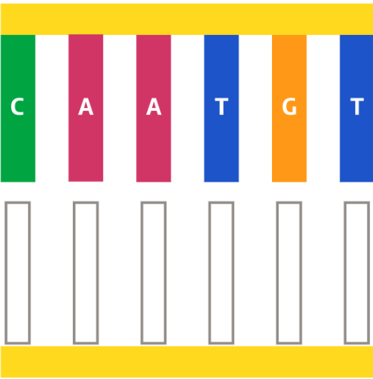
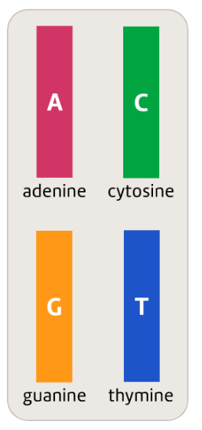
One side of a section of DNA is shown. Complete the other side of the molecule by adding bases.

Slide 8
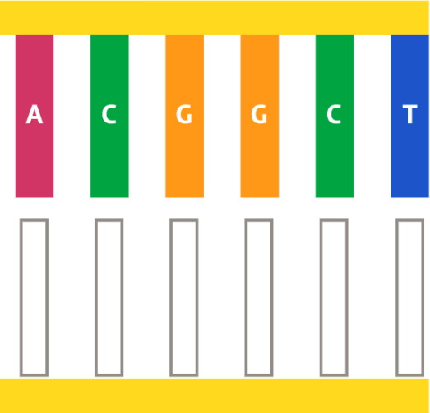
One side of a section of DNA is shown. Complete the other side of the molecule by adding bases.

Slide 9
If 30% of the bases in a particular DNA molecule are guanine (G), calculate the percentage of the bases would be thymine (T). Explain your reasoning.

Slide 10
If 20% of the bases in a particular DNA molecule are adenine (A), calculate the percentage of the bases would be guanine (G). Explain your reasoning.

Slide 11
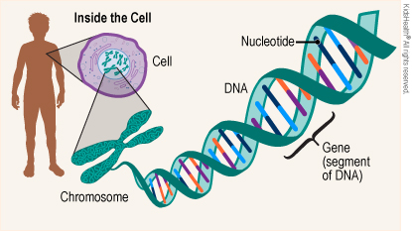
Genes
Genetic information is passed down from one generation to the next in packets or units.
These are known as genes.
A gene is a section of a DNA molecule that provides instructions for building a specific protein.
Humans have about 20,000 genes.
Teacher Cue
Active tracking, choral reading

Slide 12
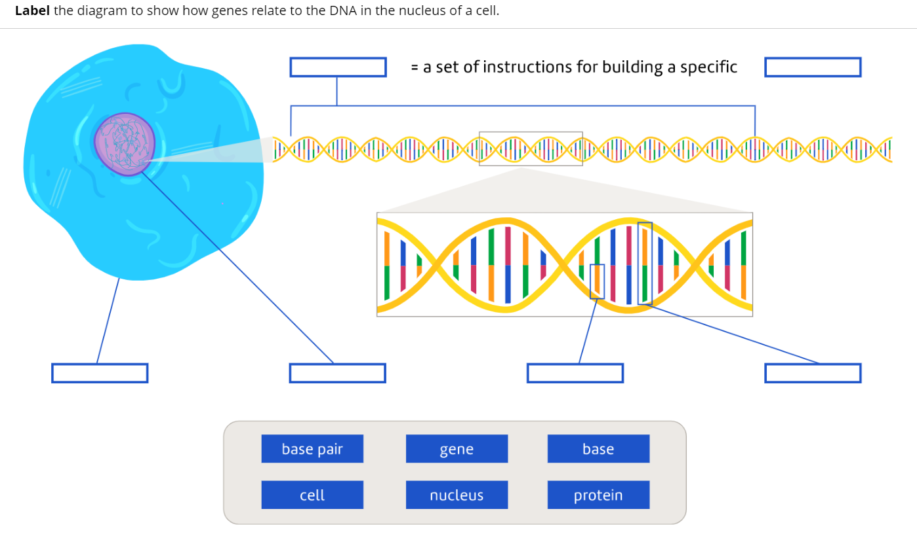

Slide 13
Mitosis and the cell cycle
Teacher Cue
Active tracking, choral reading
Two types of cell division take place in the human body:
Mitosis: Cell division for growth and repair
Meiosis: Cell division for production of sex cells

Slide 14
Mitosis and the cell cycle
Teacher Cue
Active tracking, choral reading
Two types of cell division take place in the human body:
Mitosis: Cell division for growth and repair
Meiosis: Cell division for production of sex cells

Slide 15
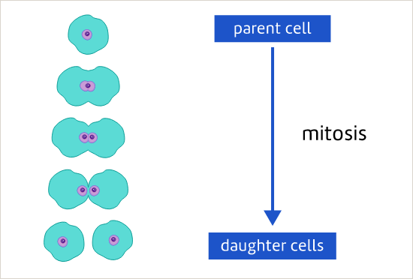
Mitosis and the cell cycle
Teacher Cue
Active tracking, choral reading
In mitosis, one cell splits in half to create two new cells.
Each daughter cell has its own nucleus, which contains DNA
The daughter cells are genetically identical to each other and the parent cell

Slide 16
Mitosis and the cell cycle
Teacher Cue
Active tracking, choral reading
In mitosis, one cell splits in half to create two new cells.
Each daughter cell has its own nucleus, which contains DNA
The daughter cells are genetically identical to each other and the parent cell

Slide 17
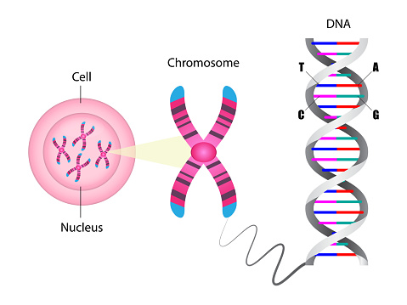
Chromosomes
Teacher Cue
Active tracking, choral reading
There are 46 separate strands of DNA in most human cells.
These are called chromosomes

Slide 18
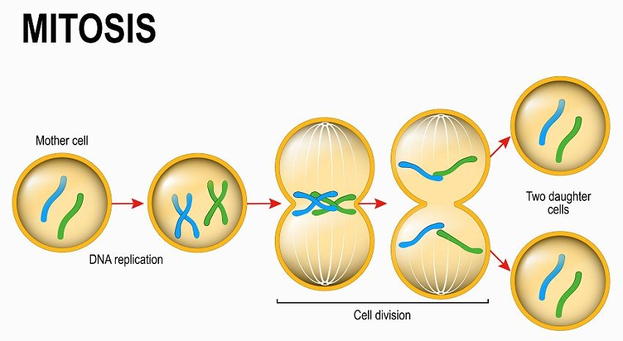


Chromosomes
Interphase - During this time the cell grows, replicates its chromosomes, and prepares for cell division.
Prophase (Prepare) – the cell Prepares for division: the chromosomes condense and the nucleus starts to break down
Metaphase (Middle) – the chromosomes line up along the Middle of the cell
Anaphase (Away) – the chromosomes separate and are dragged Away from each other
Telophase (Two) – Two nuclei form, each with its own set of identical DNA

Slide 19
Chromosomes
Interphase - During this time the cell grows, replicates its chromosomes, and prepares for cell division.
Prophase (Prepare) – the cell Prepares for division: the chromosomes condense and the nucleus starts to break down
Metaphase (Middle) – the chromosomes line up along the Middle of the cell
Anaphase (Away) – the chromosomes separate and are dragged Away from each other
Telophase (Two) – Two nuclei form, each with its own set of identical DNA

Slide 20
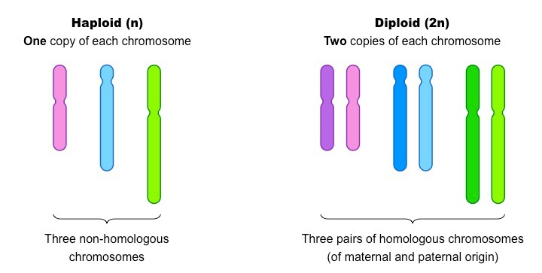
Chromosomes
Teacher Cue
Active tracking, choral reading
Cells can vary in the number of chromosomes they have:
Diploid Cells (Created from Mitosis):
A cell that contains two copies of each chromosome
One copy from each parent
All cells except sex cells are diploid

Slide 21
Chromosomes
Teacher Cue
Active tracking, choral reading
Cells can vary in the number of chromosomes they have:
Haploid Cells (Created from Meiosis):
A cell that contains one copy of each chromosome
Gametes only (sperm and egg cells)

Slide 22
Mitosis | Both | Meiosis
Sort the following features into Mitosis, Meiosis, or Both
Diploid cells
IPMAT
Sexual reproduction
IPMAT-MAT
Daughter cells have 23 chromosomes
Asexual reproduction
Haploid cells
Starts with one cell
Goes through two stages of division
Goes through one stage of division
Involves chromosomes and DNA
DNA replicates in Interphase

Slide 23
Mitosis | Both | Meiosis
Diploid cells
DNA replicates in Interphase
Haploid cells
IPMAT
Starts with one cell
IPMAT-MAT
Asexual reproduction
Involves chromosomes and DNA
Sexual reproduction
Goes through one stage of division
Goes through two stages of division
Daughter cells have 23 chromosomes

Slide 26
Cue Boxes
Do not delete this slide. It is hidden from your show. You can use it to copy and paste the relevant prompt boxes into your presentation. Click once on the white space to select it for copying. Once it is in your presentation you can double click on the white space to add text. The box will automatically resize to fit your text. The next slide is also hidden and included as an example only.
Teacher Cue
CFU
Vocabulary
Extension

